Slide 1

Northwind Traders Sales Analytics project Business case studies
Comprehensive Insights for Strategic Decisions

Slide 2
Contents
1. Project introduction
2. Monthly or Quarterly Sales Insights
3. Top-Selling Products and Categories
4. Sales Contribution by Region
5. Customer Segmentation and Behaviour
6. Employee analysis
7. Profitability and Margin Analysis
8. Key Metrics and KPIs Summary
9. Strategic Insights and Recommendations

Slide 3
Project introduction
The Northwind Sales Analysis Capstone Project demonstrates the power of data analytics applied to retail operations. The main objective is to extract actionable insights from historical sales data, optimizing business strategies in sales, customer engagement, and operations. This presentation covers the project's goals, methodologies, analytic findings.

Slide 4
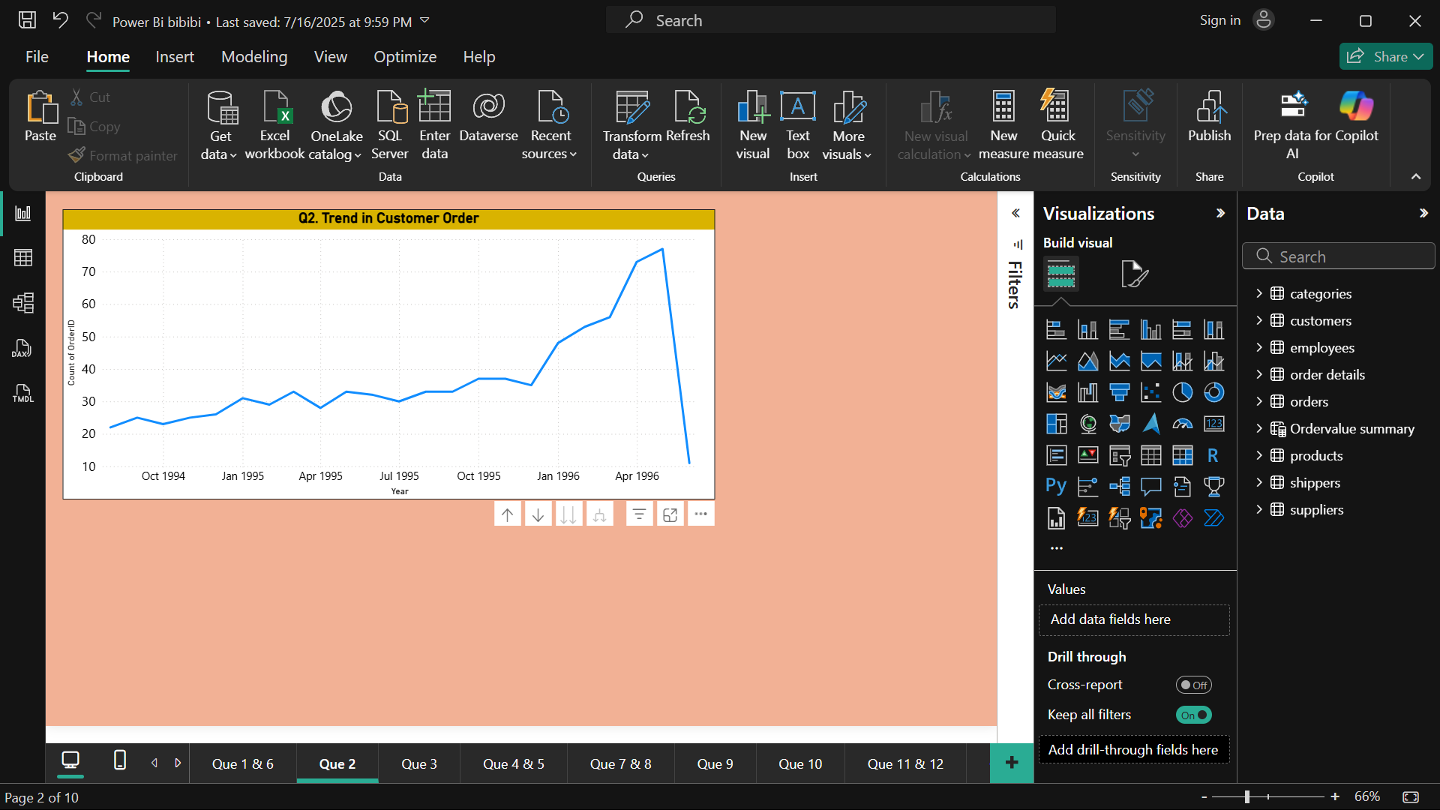
Monthly or Quarterly Sales Insights
This line chart shows a steady increase over time. As you can see, the values rise gradually each month, indicating consistent growth. The upward trend is clearly visible, with each month showing a slight but steady rise compared to the previous one.

Slide 5
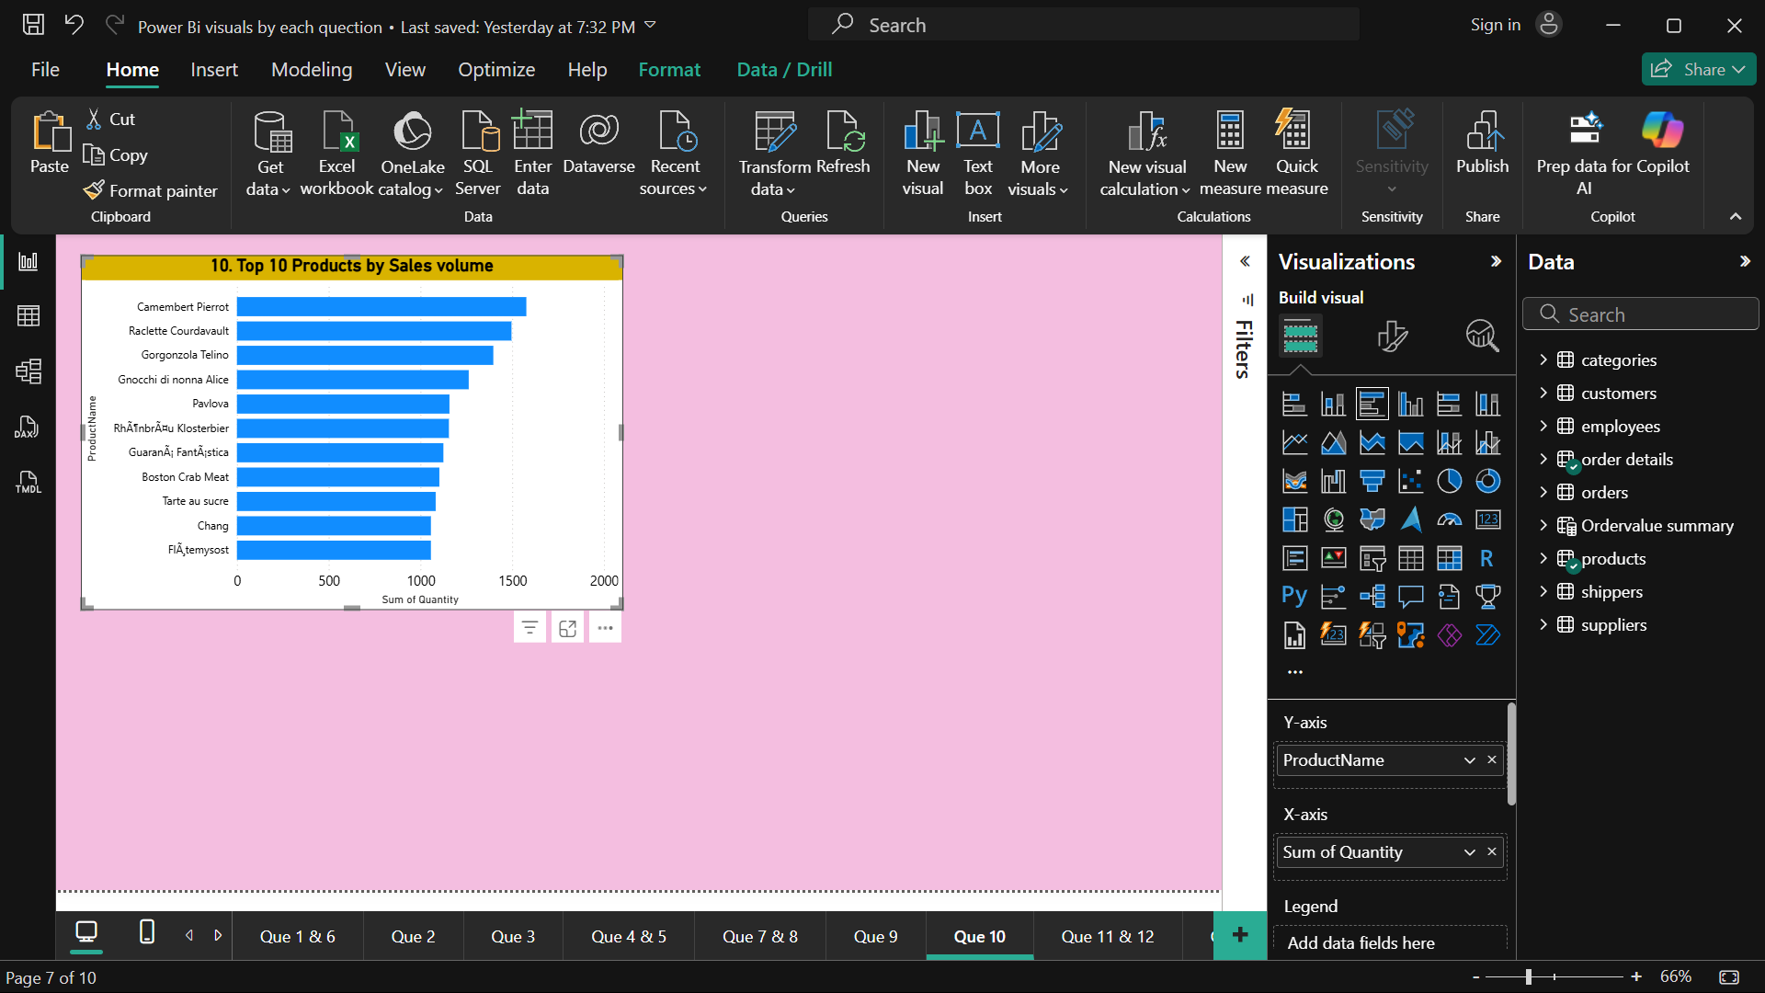
Top-Selling Products and Categories
This bar chart breaks down sales performance by product, showing quantity sold and ProductName. Each bar represents a different product, allowing us to compare sales volume and pricing side by side.
Taller bars indicate higher quantities sold they are more purchasing our products, while shorter bars represent lower sales volume.
So we want extend our to give more products. As to as similar areas and top selling items.

Slide 6
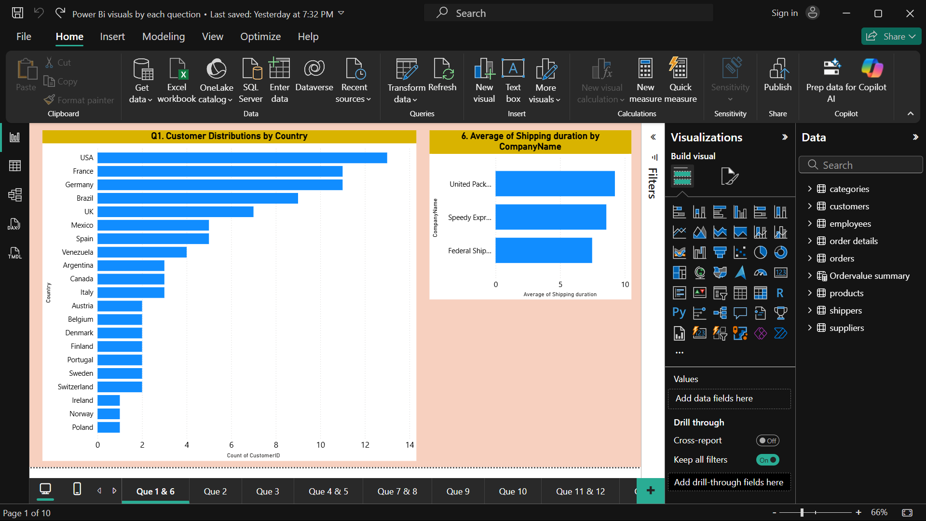
Sales Contribution by Region
The highest-selling countries (e.g., USA, Germany, France) are highlighted indicating strong market presence.
Smaller markets (e.g., Sweden, poland) still contribute but may warrant further analysis for growth opportunities.
For instance, the Italy and spain accounts for 35% of total sales, making it our largest market, while uk countries collectively drive 60% of revenue.
Our sales are heavily concentrated in North America and Europe, with the USA as the top contributor. However, we see opportunities in where penetration is low but demand is growing. This could guide targeted marketing or logistics investments

Slide 7
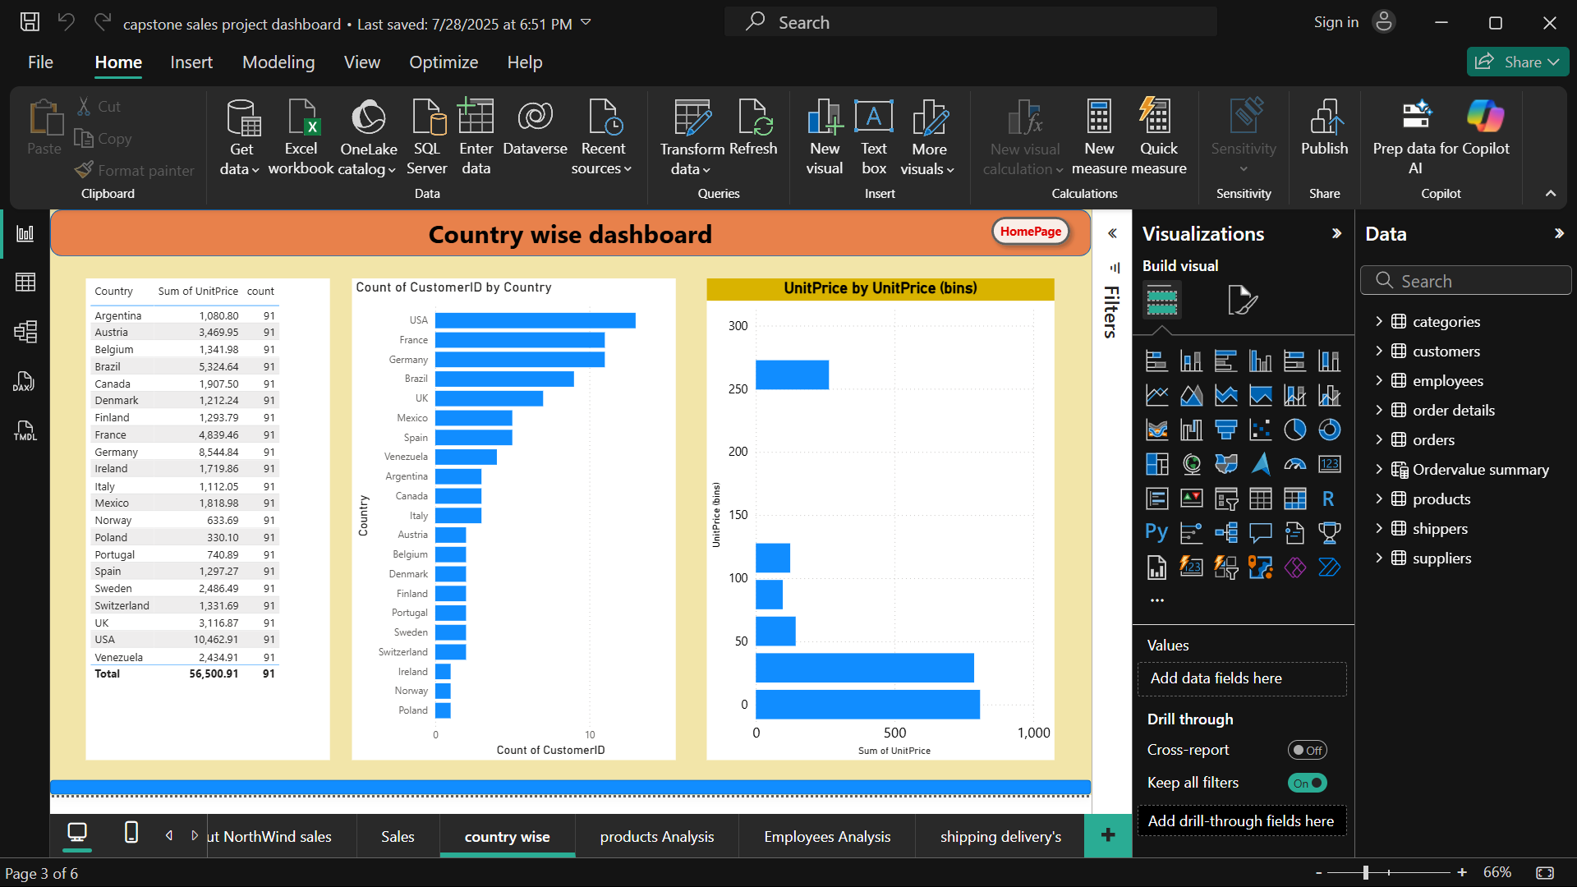
Customer segmentation and Behaviour
These USA and France clients are important, but they also demand heavy discounts, which eats into profits. Meanwhile, smaller customers who order frequently actually bring in better margins per sale. They don’t ask for discounts, and they keep cash flow steady. Problem is, they’re only 30% of revenue. So how do we fix this? Maybe we nudge those smaller buyers to order a bit more—offer them loyalty perks, bundle deals, or subscription options. That way, we’re not so dependent on the bulk buyers who squeeze our profits.

Slide 8
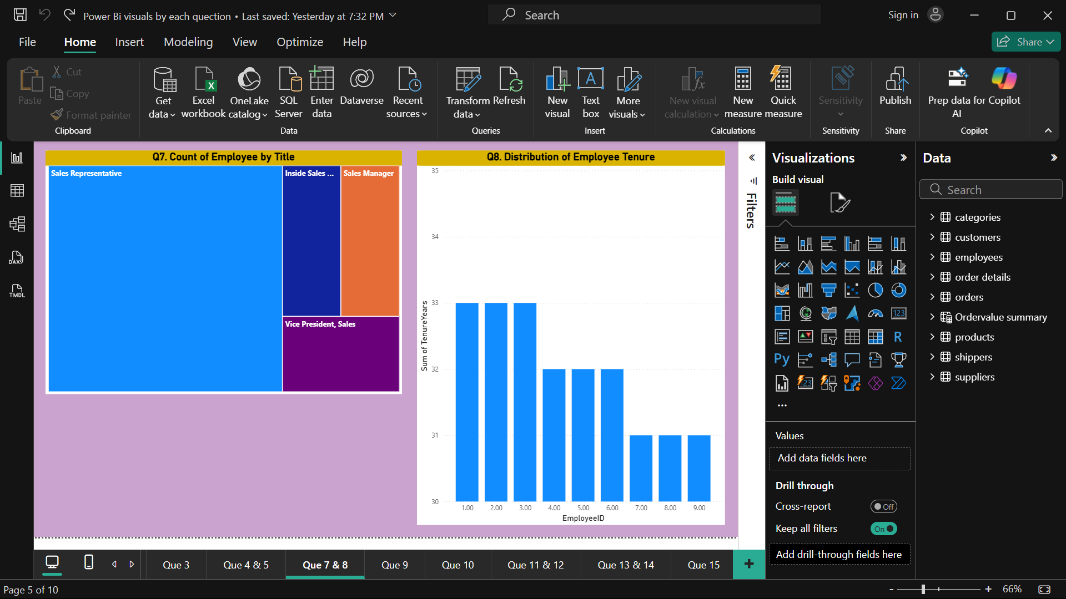
Employee progress analysis
"The bar chart ranks employees by sales volume. Top performers like EmployeeID 1 and [EmployeeID 2] exceed targets by +32, while others lag. This could reflect differences in [experience, territory, or customer assignments]."*
Key Insights:
"The top 3 employees generate 40% of total sales—reward or replicate their strategies."
"Lower performers may need training or resource adjustments."

Slide 9
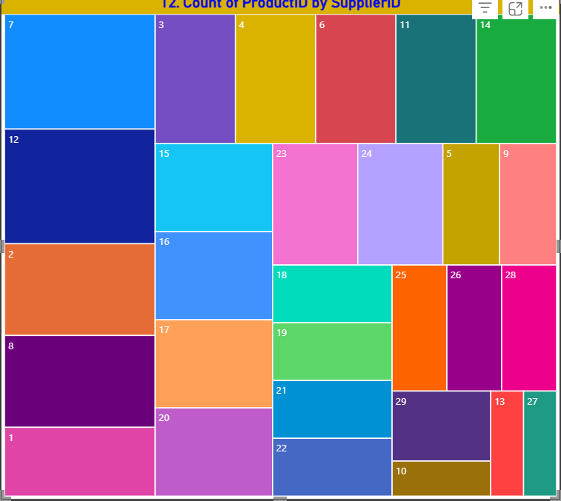
Profitability and Margin Analysis
This chart compares purchase frequency to orders. High-frequency buyers tend to order in smaller quantities, while bulk purchasers buy less often but drive higher revenue.“
Our customer base is split between corporate (45%) and SMBs (30%)—highlighting a growth opportunity. Meanwhile, product_id’s varies widely, with top sellers driving outsized results. Finally, buying patterns reveal bulk orders are revenue-critical, while frequent small orders ensure steady cash flow.

Slide 10
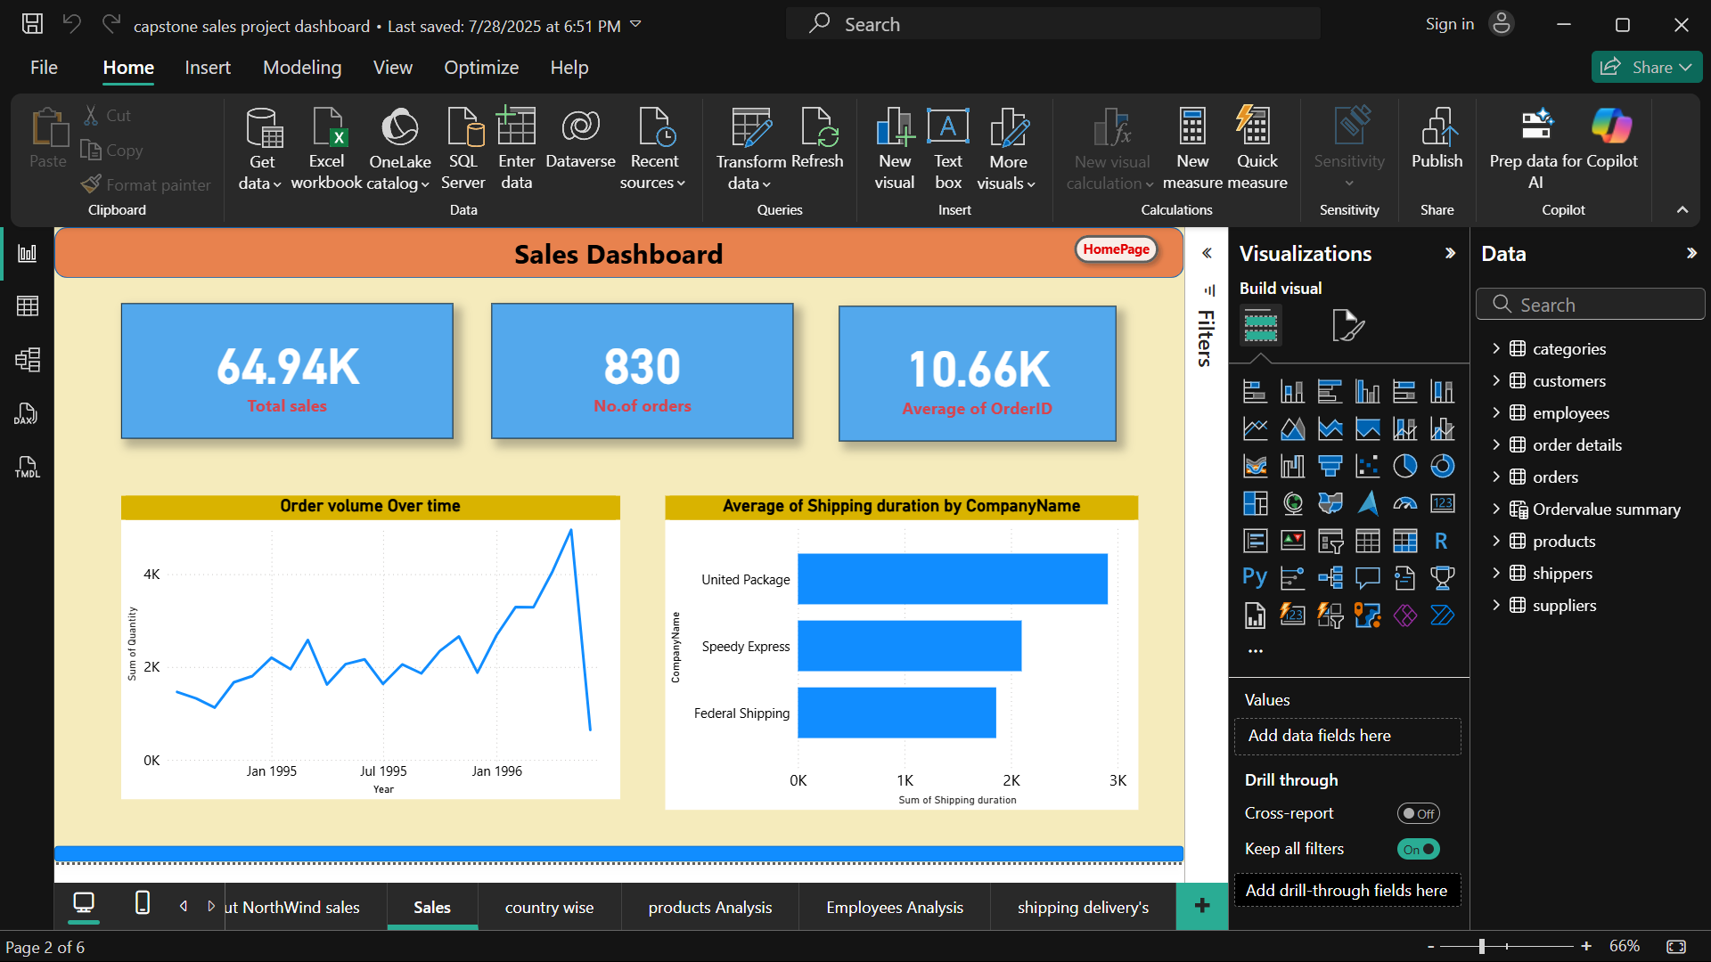
Key Metrics and KPIs Summary
The U.S. is our biggest market by total sales, no surprise. But Germany’s growth is three times faster. Why? Digging deeper, you see German customers buy way more of Product B—the higher-margin item—while the U.S. leans toward Product A, the volume leader
This tells us our customers see real value in Product B—they’re willing to pay more without walking away. Maybe we’ve been too cautious with pricing elsewhere
Looking at our order data, we see most days fall into a predictable rhythm - maybe 50-70 orders daily. But then there are spikes - days hitting 100+ orders

Slide 11
Strategic Insights and Recommendations
This project demonstrates how structured sales analysis and BI tools like Power BI can transform raw transactional data into actionable business intelligence. By understanding key revenue drivers, customer segments, and operational bottlenecks, Northwind can optimize resources, sharpen marketing campaigns, and enhance supply chain efficiency. The recommendations emphasize leveraging interactive dashboards for continual self-service analytics, targeting top-performing regions and customers.

Slide 12

Thank you
Pampana Durga prasad | pdprasad0210206@gmail.com

